Slide 1
How to Demonstrate Purpose and Attract Capital with BIG2™
Darren Engels, CEO
May 22, 2025

Slide 2

Tailwind Ventures
My journey from sell-side energy analyst
Copenhagen, April 2017
FirstEnergy: smarter people, better capitalized, better infrastructure, and better in every way – but no longer exists
Diligent preparedness: capital readiness for those who respect capital
Make an impact… BIG2™
Darren Engels, CPA CA, CFA
CEO
20+ years in investment banking and
working with ventures
Notes:
JENNY & DARREN

Slide 3

INVESTOR PERCEPTION IS REALITY.
We empower companies to be diligently prepared.
Notes:
Vision + purpose = what is our big2 (implicit)

Slide 4

Your capital readiness partner
OUR CLIENTS
Earlier-stage companies pursuing a founder-led capital raise
Later-stage companies who require a facilitated raise or exit transaction
Tailwind works with ventures over the course of your growth journey to enable capital readiness and capital access.
Notes:
JENNY

Slide 5
“If you always do what you’ve always done, you’ll always get what you’ve always got”
Are You Meeting Investors Where They Are?

Slide 6
Meta-Analysis
Core Theme: Everyone is competing on BEST
Undifferentiated Positioning
Zero Differentiation
Geographic / asset focus (100%)
Growth strategy and opportunities (100%)
Financial performance and returns (100%)
Technical / operational expertise (91%)
Management and partnerships (82%)
sea of sameness
Stop competing on BEST – it’s a war that cannot be won
The investor might as well just buy CNQ (or similar)

Slide 7
Meta-Analysis
What you are not saying…
9% of companies explicitly connected their purpose to shareholder value creation
55% of companies mentioned sustainability themes, but only 18% connected those initiatives to financial performance… intentional or just words?
18% of companies directly mention returning capital to investors or exit strategies… it’s their money, when are they getting it back?

Slide 8
“I just need the investor list.”
WHAT WE HEAR

Slide 9
IN REALITY
An investor list does not result in capital.
Diligent preparedness does.

Slide 10
The Tailwind Way
DILIGENT PREPAREDNESS:
(noun)
The state achieved by:
the proactive process of developing and documenting a company's operational, financial, and strategic competencies;
the sustained, intentional effort to build a robust foundation of verifiable evidence that demonstrates the company's ability to generate impact and value;
the consistent hard work of demonstrating competency that earns trust, which attracts capital.

Slide 11
The Current Landscape
THE NEED FOR PURPOSE AND PROFIT

Slide 12
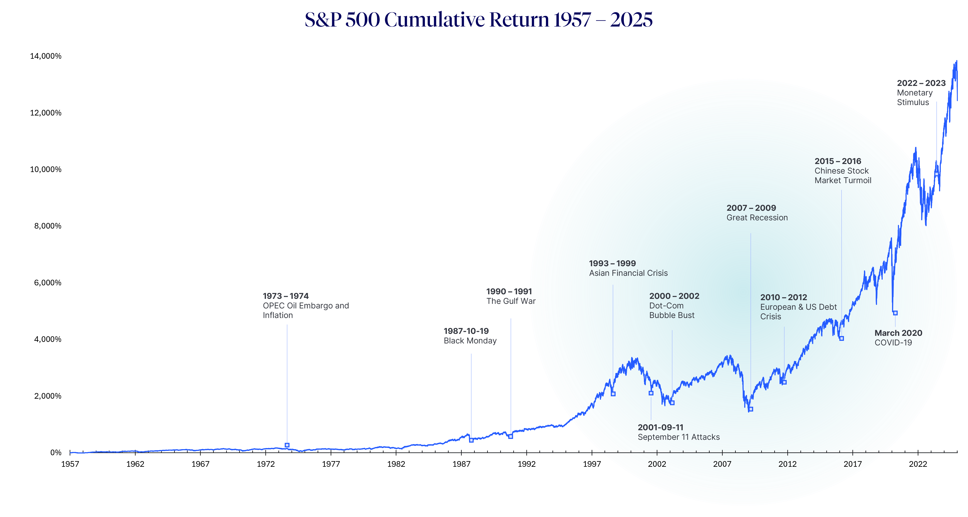

Slide 13
of that 0.5%,
0.5%
only a few
of companies who pitch venture capital firms are successful in securing investment.
have a successful exit.
Notes:
DARREN

Slide 14
Let’s discuss.
Notes:
DARREN invite questions
JENNY to offer prompting questions if none from audience:
Does everyone understand the 2 and 20 model (How investors make money)?
A lot of the data comes from the U.S. Can you talk about how we as Canadians should understand that data?

Slide 15
What sets successful fundraisers apart is their ability to craft and articulate a compelling narrative,
with the evidence to prove it.
A story that aligns vision, purpose and a business trajectory that impacts both non-financial and financial goals.
We call it BIG2™.
Notes:
JENNY

Slide 16
Building the Narrative
Evidence-Based Narrative
Vision
Purpose
BIG2™
Notes:
JENNY

Slide 17
What Impact Will You Make?
What is Your Vision, Purpose and Reason for Existing?

Slide 18
vi·sion
the act or power of seeing, something seen in a dream, and the act or power of imagination.
the ability to think about or plan the future with imagination or wisdom.
n.
Investors need to want to join this dream.
Notes:
DARREN
Investors need to want to join this dream
Long term aspiration
Bold vision, counteracting fear of being way out there along
Importance of a grand vision to inspire

Slide 19
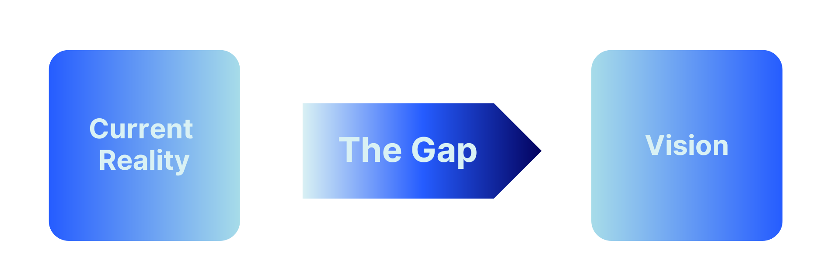
Vision Needs Execution
Vision without action is daydream.
Action without vision is nightmare.
Proverb
Notes:
A dream alone is not investable. Strategic planning and execution are essential to secure resources..
Emphasize the combination of excellent strategic execution and creativity for change in realizing the vision.
Vision (aspiration & inspiration) meets Execution (conviction & discipline)
Underscore that a compelling vision must be supported by a concrete plan and the ability to execute effectively.).

Slide 20
pur · pose
the reason something is done or created or for which something exists.
a person’s sense of resolve or determination.
n.
Investors need to understand why your company exists.
Notes:
DARREN

Slide 21


Vision vs. Purpose: Destination vs. Journey
VISION
Aspirational, inspiring, long-term view.
The destination – what the company aims to become.
PURPOSE
The company's WHY – fundamental reason for existing.
The planned impact the company will make.
“The brands that will thrive in the coming years are the ones that have a purpose beyond profit.”
- Richard Branson
Notes:
DARREN
Vision is where you're going; Purpose is why you're making the journey. Both are crucial for a strong narrative.
A vision without PURPOSE is a fantasy.

Slide 22
What Is BIG2™
THE GOAL OF ALL GOALS

Slide 23
Linking narrative to financial impact
BIG2™
n.
Big Impact Goal x2.
a strategic framework that empowers business to achieve extraordinary impact, resulting in exceptional financial performance.
a dual-pronged approach that transforms vision and purpose into measurable, achievable impact and financial outcomes.
Notes:
BIG2 was the brainchild of Darren – because BHAG (used across other business canvas type models) was insufficient to for the investor audience
BHAG ultimately falls short in that setting a large goal ignores that the business can have a meaningful social impact, while also generating a financial return to stakeholders.

Slide 24
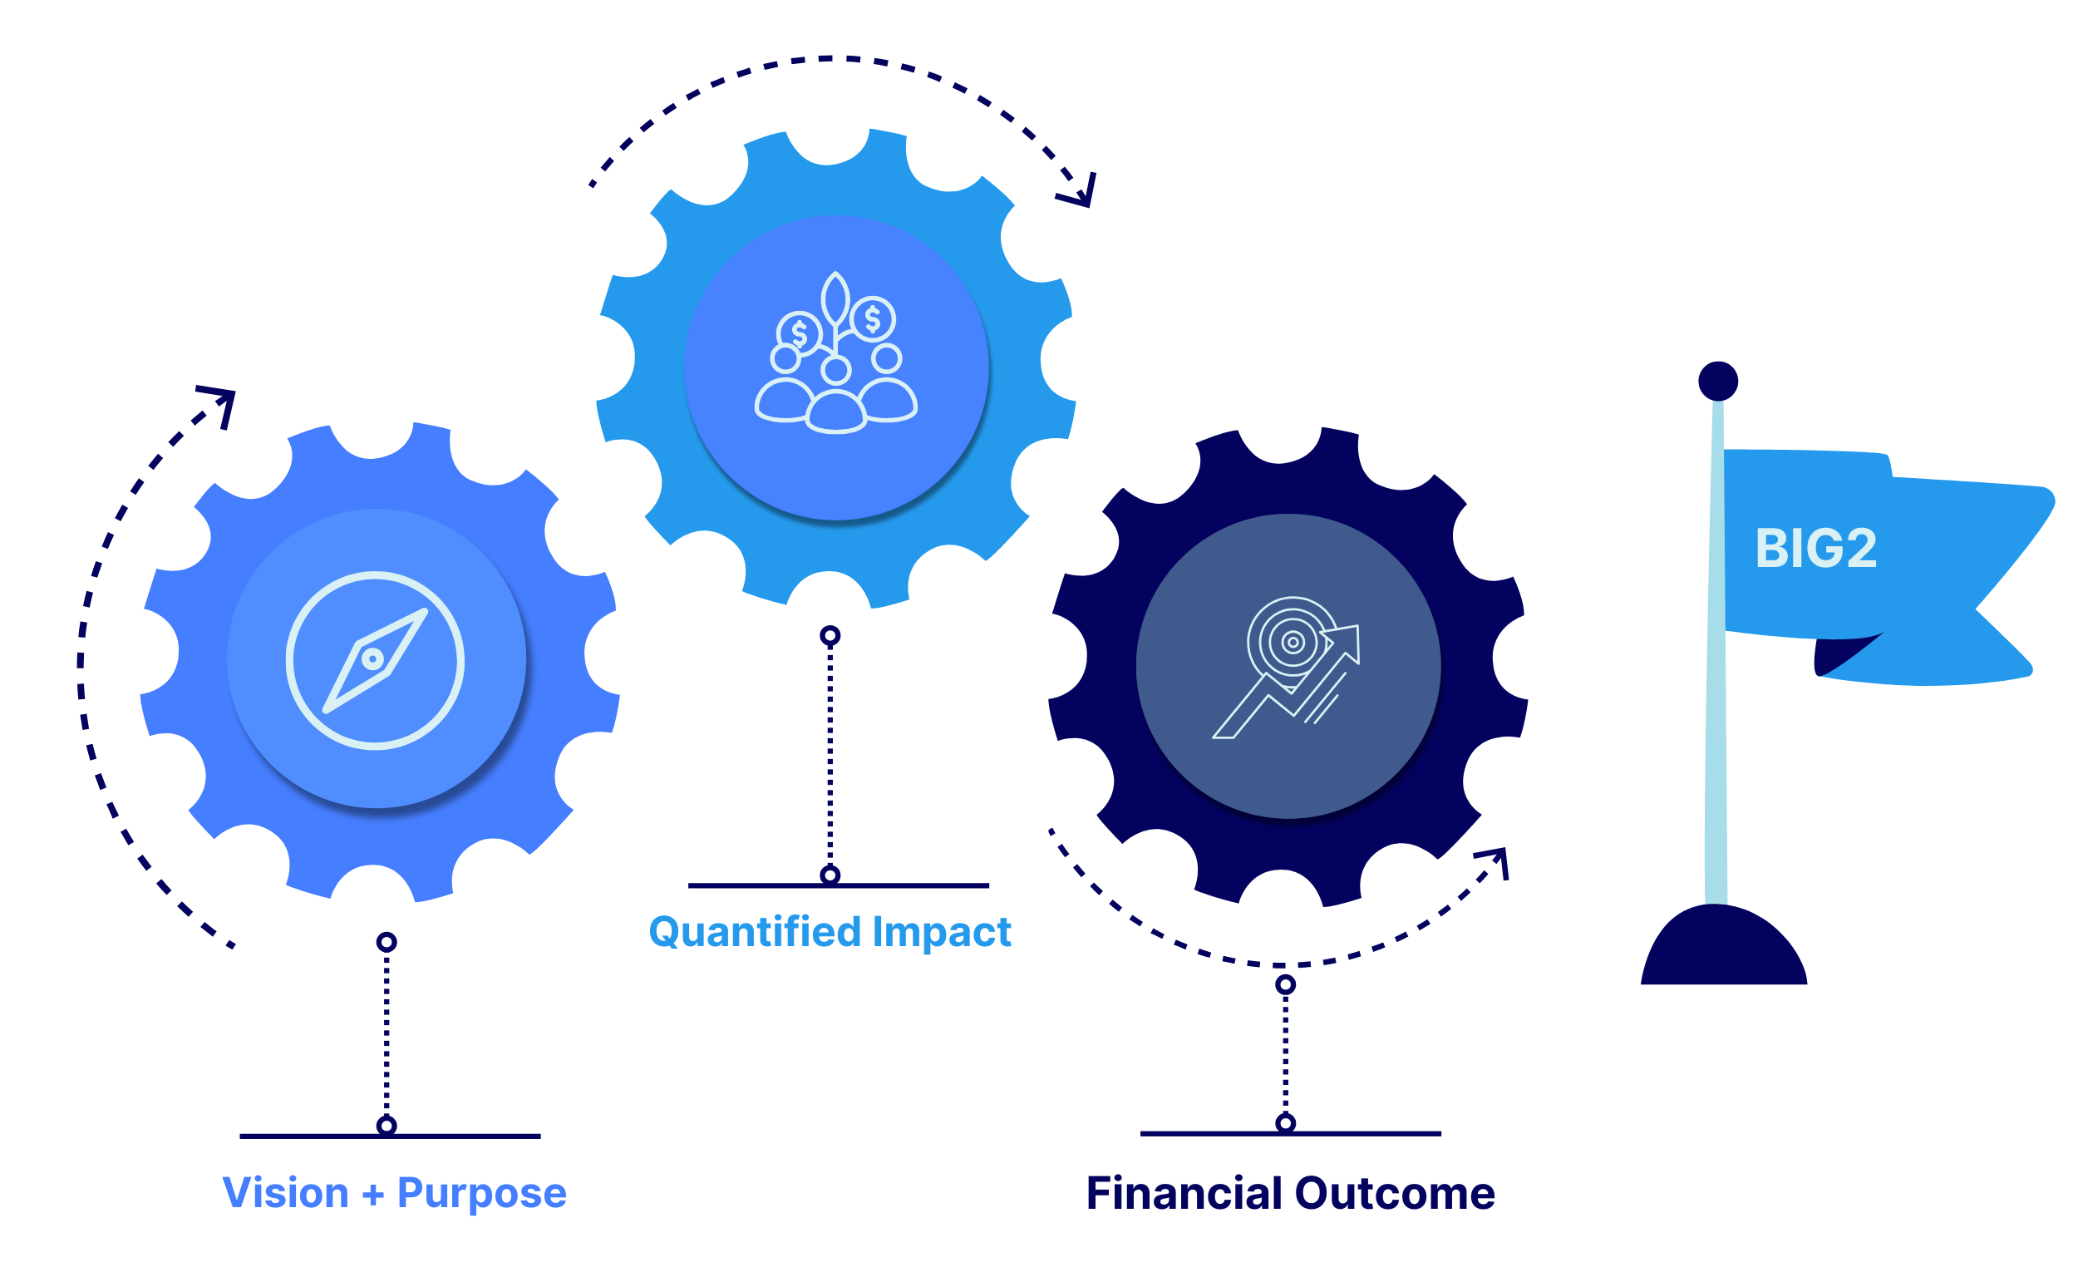
Building your BIG2™
™
Notes:
Define and Quantify the First BIG
After the company’s vision and purpose have been articulated, set ambitious but realistic goals of the first BIG that reflect the company’s vision and purpose. The goals need to be SMART – Specific, Measurable, Achievable, Realistic, and Time-Bound.
What is the biggest impact that you could have on your world or community? How would you quantify this impact?
At what point in the future timeline of the business might you to be able to achieve this?
Has the first BIG been aligned with the company’s organizational strategy?
Does the First BIG align with the company’s culture and core values? How? Can you prove it?

Slide 25
BIG2™ Framework
BIG2™ (Big Impact Goal x2) has two distinct, but related and complementary declarations, supported by evidence:
1 | The first BIG captures the impact, describing how [Company] will positively impact the communities or ecosystems in which it operates. | 2 | The second BIG captures the financial outcomes, describing how [Company]’s impacts will translate into strong economic outcomes.

Slide 26
Case study: Impact in Oil & Gas
“We have the best land”
Traditional O&G Companies are inherently the SAME
Commonly used selling points…
“We have the best decline curve”
“We have the best reserves”
-There is nothing compelling. If it is just selling a molecule, it doesn’t matter where I get it, so I might as well go to the lowest risk adjusted return.
An Alternative Example: Natural Gas to Sustainable Aviation Fuel
ClearSky has introduced technology that converts natural gas to clean aviation and diesel fuel.
Solution encapsulates more than production and financial return…
ClearSky will enable emissions reductions and job creation in aviation and transportation by displacing traditional fuel, while concurrently creating a new market for natural gas.
Notes:
DARREN
Clearsky
Our vision is to deploy transformative fuel technologies that fundamentally change the way Canada approaches petrochemical energy sources.
Our purpose is to accelerate the global effort toward net-zero operations in the aviation and transport sectors.

Slide 27
Impact-to-Financials: Rubric
1 | 2 | 3
Complete | Better | Investor Ready
The First BIG and Second BIG are consistent. There is a clear link between achieving the First BIG (positive impact) and the Second BIG (financial outcome). | The First BIG is consistent with the company’s vision, purpose, culture, and core values. The Second BIG is clear and quantifiable. | BIG2 is consistent with the company’s TAM, financial model, and other quantitative metrics that are used to evaluate the company and investment opportunity.

Slide 28
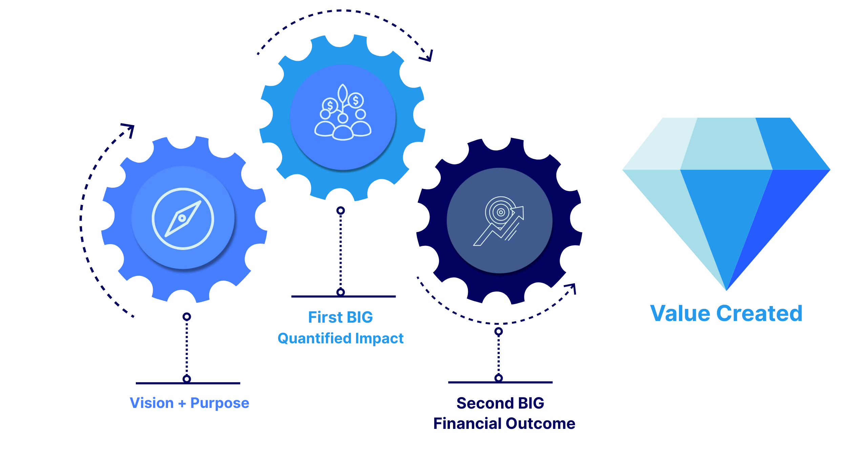
Evidence-Based Narrative is your advantage
Notes:
DARREN
With value created (or a picture of that value to be created), the company can now address a future liquidity and/or exit strategy. Remember, it is incumbent on the Company’s Executive Team and Board of Directors to return capital to investors.
In any environment, there is competition for capital, only the degree of scarcity changes in bullish or bearish times. And given that humans want to be entertained by story and emotionally connected, storytelling is not optional – it is essential. Companies that master the art of evidence-based narrative differentiate themselves, gain the emotional connection, and therefore trust of the investor faster, and secure the necessary funding needed to scale to realize the vision.

Slide 29





Five steps to an Evidence-Based Narrative
Imagine and declare your vision.
Define your purpose and reason for existence.
Map out BIG2™, aligning quantified impact to financial outcomes.
Support with data—tell them how and prove it.
Deliver your evidence-based narrative with confidence.
Notes:
DARREN

Slide 30
Let’s discuss.
Notes:
DARREN invite questions
JENNY to offer prompting questions if none from audience:
Does everyone understand the 2 and 20 model (How investors make money)?
A lot of the data comes from the U.S. Can you talk about how we as Canadians should understand that data?

Slide 31
Thank you.
CONTACT US
150 9 Ave SW Suite 940
Calgary, AB, T2P 3H9
(403) 618-8035
info@tailwindventures.co
tailwindventures.co

